Slide 1

Digital Citizenship
Lesson 4
HOW YOU PRESENT YOURSELF ONLINE

Slide 2

Level 1 | Digital Citizenship
Do you think there are certain responsibilities that come with using the internet?
  What do you use the internet for?
  What does “etiquette” mean?

Slide 3

Level 1 | Digital Citizenship
What is Netiquette?
What does the word “etiquette” mean to you?

Slide 4
Level 1 | Digital Citizenship
Netiquette
Internet
Etiquette
Etiquette
The customary code of polite behaviour in society or among members of a particular profession or group.
Netiquette or Digital Etiquette
The proper rules of behaviour while using technology devices and interacting with others online.

Slide 5



Level 1 | Digital Citizenship
What do you use technology for in your personal lives?
Think!
What other uses are there for technology in your personal lives?
What do your family and friends use it for?
Play games
Do research for work
Social network
Can you name some social platforms?

Slide 6

Level 1 | Digital Citizenship
Digital Citizen
A person who has the knowledge and skills to effectively use digital technologies to communicate with others.

Slide 7

Level 1 | Digital Citizenship
Why is it important to be ethical digital citizens?
In order to safely communicate, learn, and create in an increasingly digital world.

Slide 8
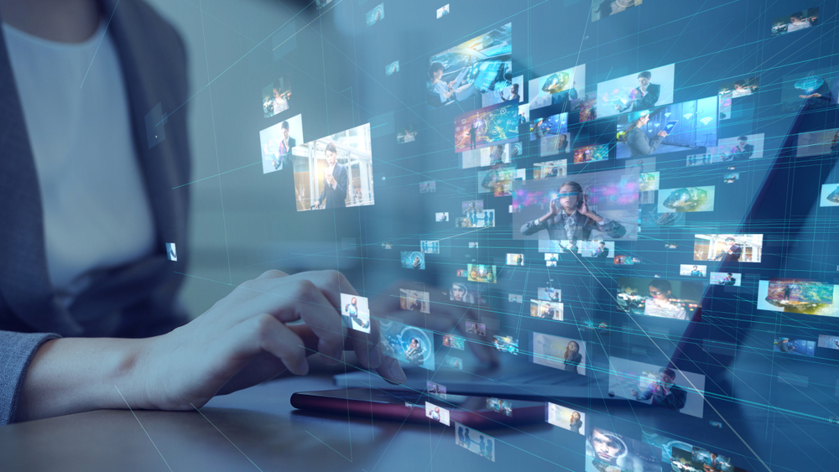
Level 1 | Digital Citizenship
Dealing with Digital Drama
Does the word “drama” have a positive or negative connotations?

Slide 9
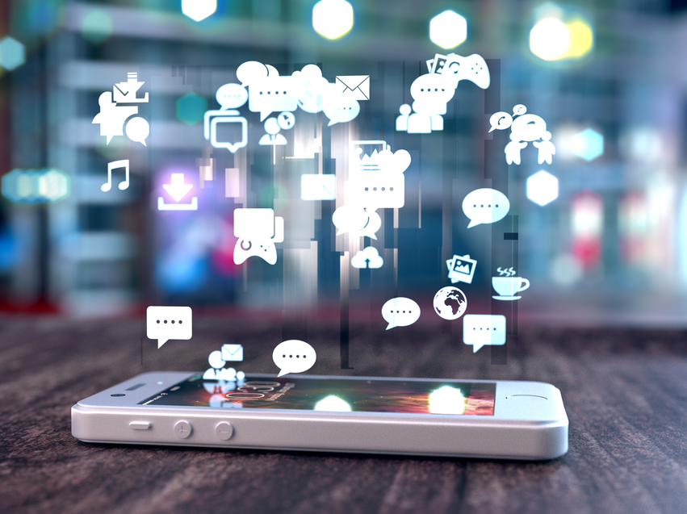
Level 1 | Digital Citizenship
Digital Drama
The everyday disputes among friends or online acquaintances.
ccc
Examples:
Hurtful comments.
Embarrassing photos.
Inconsiderate rumours.

Slide 10
Think!
What are some questions you should ask yourself before posting or sending anything?
Level 1 | Digital Citizenship
A Good Digital Citizen Has Empathy
Think!
What are some questions you should ask yourself before posting or sending anything?
How would the subject of my post feel about seeing it?
Would I want my friends, parents or teachers to read this about me?
Will this hurt the person’s reputation?
Would I say this to the person’s face?
How would I feel if someone had written that about me?

Slide 11
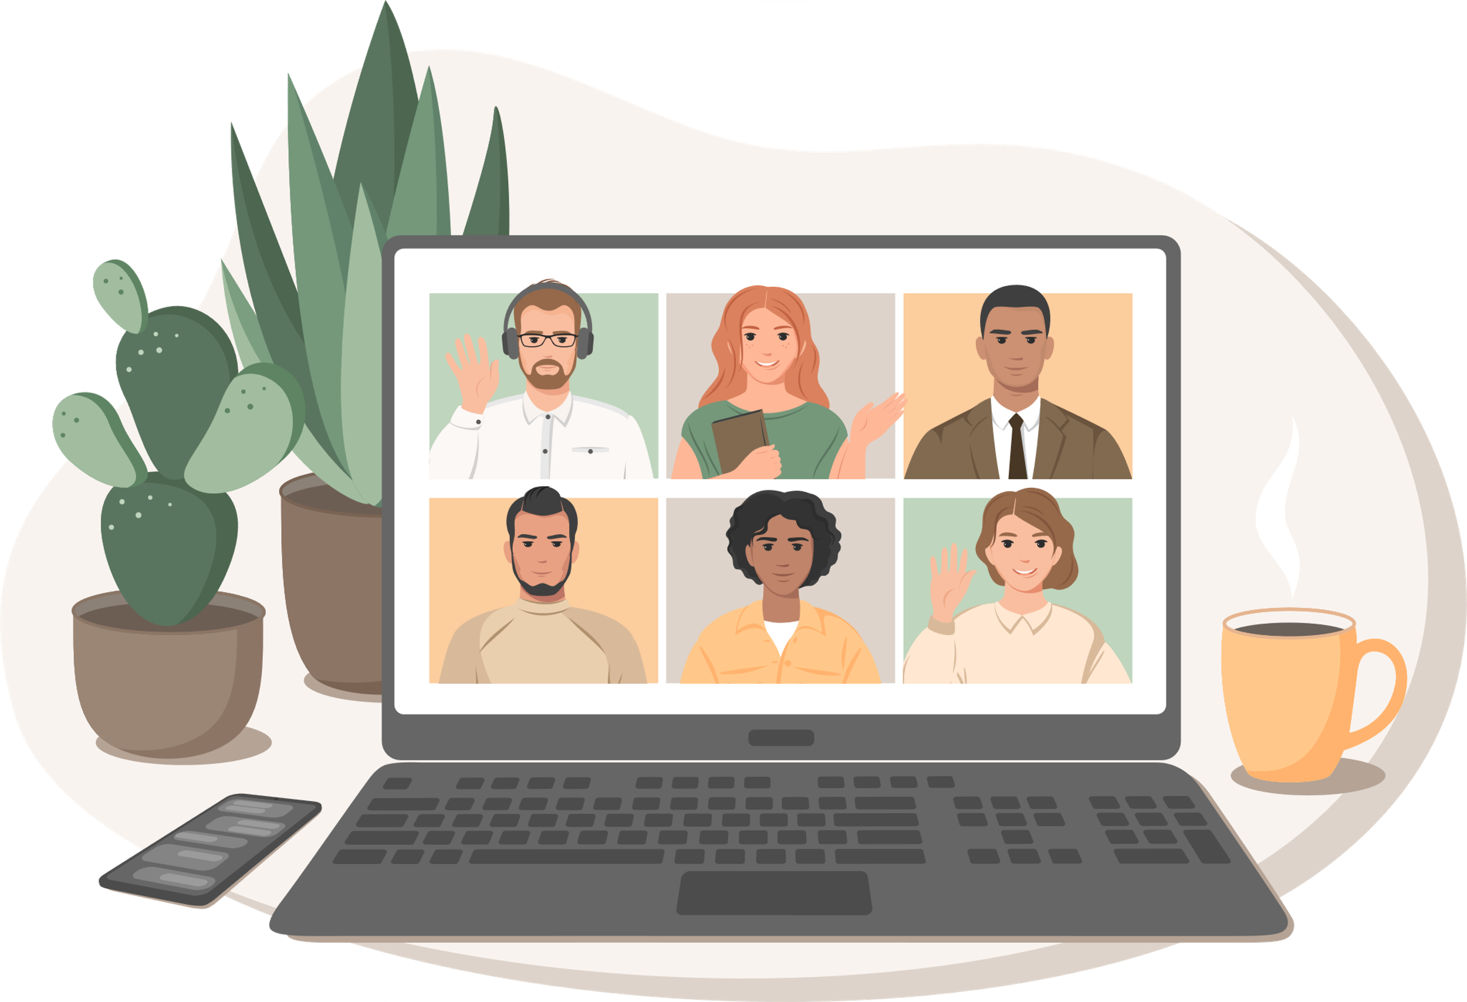
Level 1 | Digital Citizenship
Difference between Online and Face-to-face Communication
THINK!
What happens when you cannot see or hear the person you are interacting with?
Facial expression
Tone of voice
cc

Slide 12


Level 1 | Digital Citizenship
Discussion: How to Deal with Digital Drama
Notes:
https://www.youtube.com/watch?v=RydKEaiKolc&t=154s

Slide 13
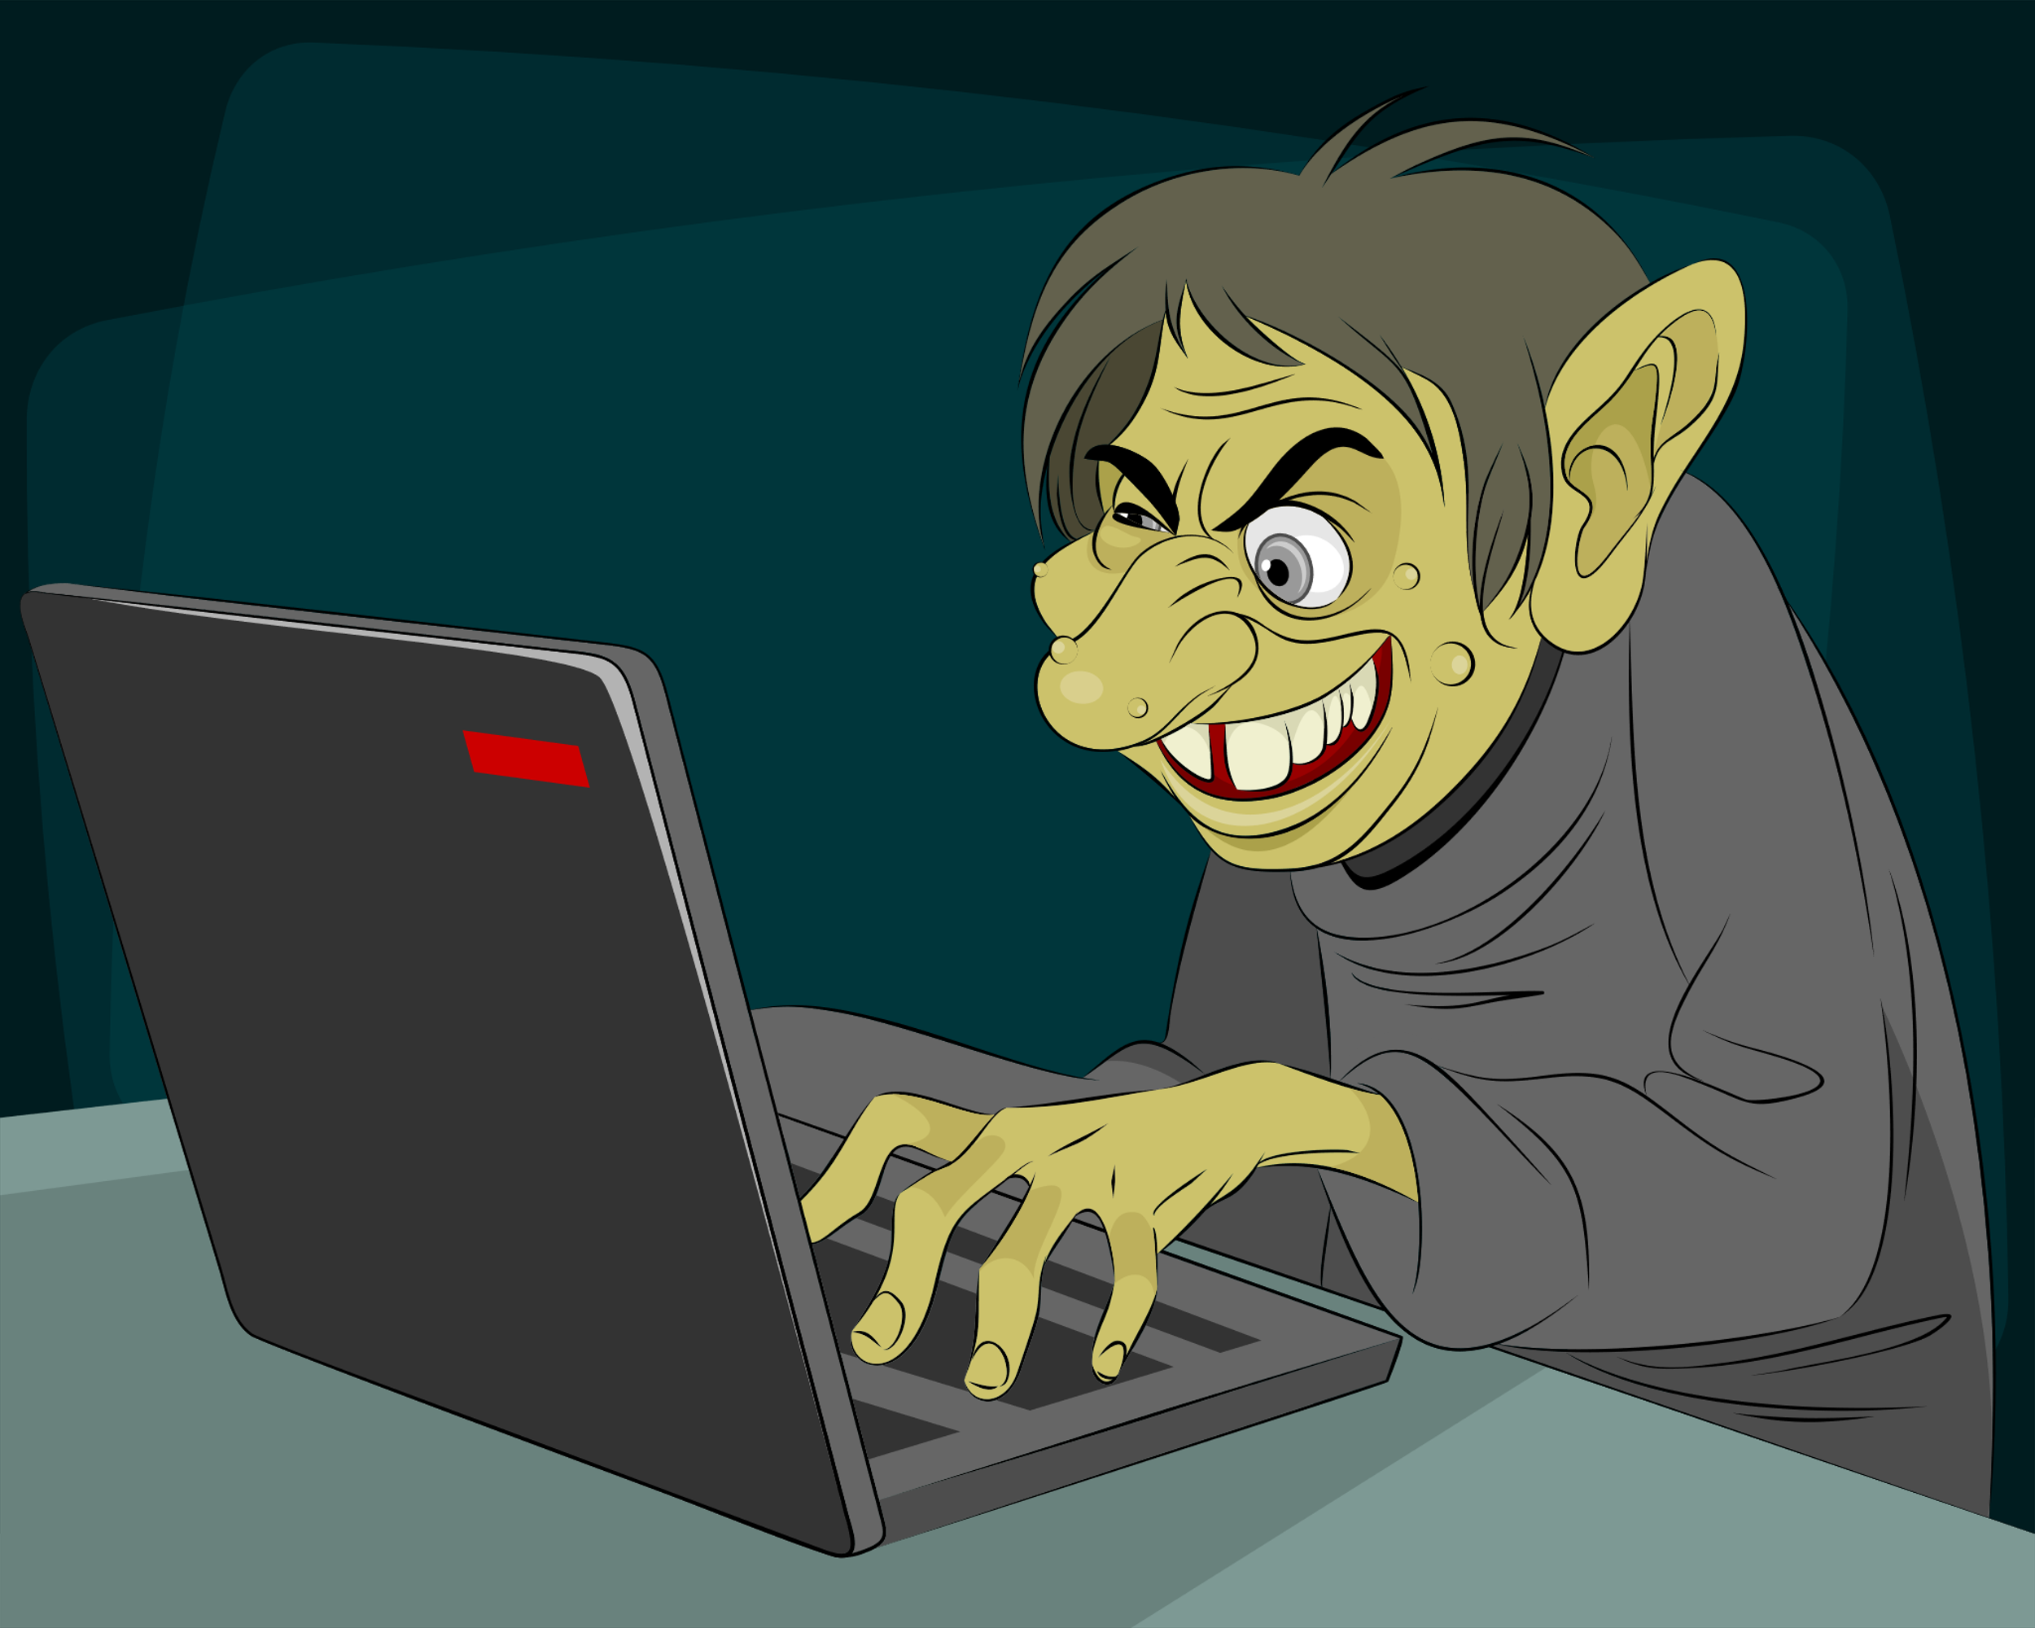
Level 1 | Digital Citizenship
The Do’s and Don’ts of Online Communication
cc
What are
“internet trolls?”
cc

Slide 14
Level 1 | Digital Citizenship
Do
Don’t
Be careful when posting on online message boards, blogs/vlogs, and discussion forums.
(def) A lengthy exchange of angry or abusive messages between online users.
Start flame wars, or succumb to the mean-spirited intentions of internet trolls.
(def) A person who posts insincere or off-topic messages in an online community, with the intent of provoking negative feelings through argument.

Slide 15
Level 1 | Digital Citizenship
Fill in the Blanks on the Left with
“DO” or “DON’T”
Communicate clearly by keeping your messages easy to read
Do
Spam your formal messages (for e.g., when replying to a teacher) with abbreviations and emoticons
Don’t
Re-read and check everything you write before sending or posting
Do
Ask permission before posting anything about your friends
Do
Write in all capital letters
Don’t

Slide 16
Level 1 | Digital Citizenship
Quiz!
1) In which situation should you follow the rules of digital etiquette?
Reading a text message from a friend
Sending an email to your grandmother
Picking the ringtone for your cell phone
Sending a birthday card to your cousin
2) What is one difference between online and face-to-face communication?
People tend to be more honest online
Miscommunications happen more frequently face-to-face
Online, you can’t tell tone of voice.
Body language is more important in online communication.

Slide 17
Level 1 | Digital Citizenship
Quiz!
3) What do internet trolls try to do?
Quietly observe
Start arguments
Lead discussions
Make friends
4) Why might people act meaner online than in person?
They can stay anonymous
Typing gives them time to consider what they say
Most people have fewer friends online
Social media sites encourage users to argue

Slide 18
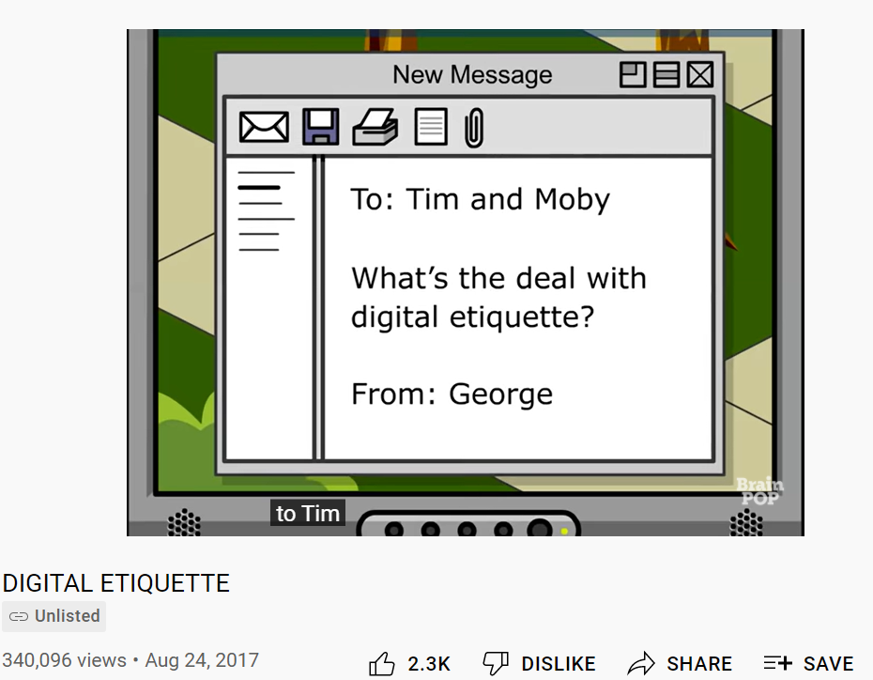
Level 1 | Digital Citizenship
Activity: Interactive Digital Etiquette Worksheet

Slide 19
Level 1 | Digital Citizenship
A Good Digital Citizen…
Some Ideas How You Can Do That
Seek inspiration and follow feeds that inspire you
Unfollow negativity
Treat others kindly in the comments
Promote someone else’s work
Be available to listen and offer support
Spreads goodness
Encourages positivity
Provides support

Slide 20
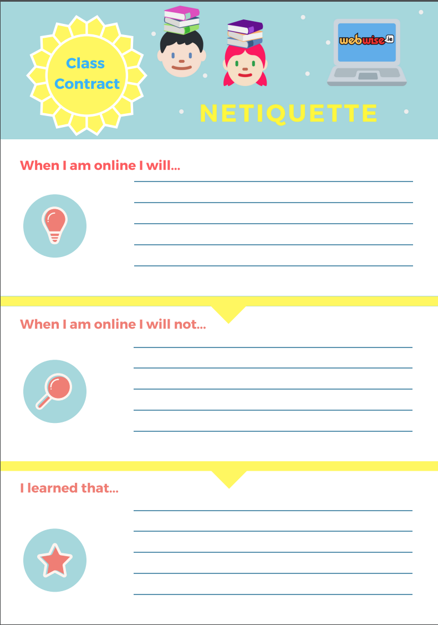
Class Activity
Your Task:
You have been appointed to design a Class Contract based on the do’s and don’ts of good online communication for your school.
In your groups, discuss your own experiences and write down all the rules you should apply to online scenarios as a good digital citizen.

Slide 21
Ready?
Now, fill up this sheet.

Slide 22

Created by

