Slide 1

Digital Citizenship
Lesson 12
PROTECTING YOUR PERSONAL DATA

Slide 2

Online requests
Have you heard of a pop-up?
What are your favourite online activities? Why?
When you visit a new website, have you been asked for personal information? What kind of requests have you seen?
Where there any requests which seemed suspicious?
What did you do?

Slide 3

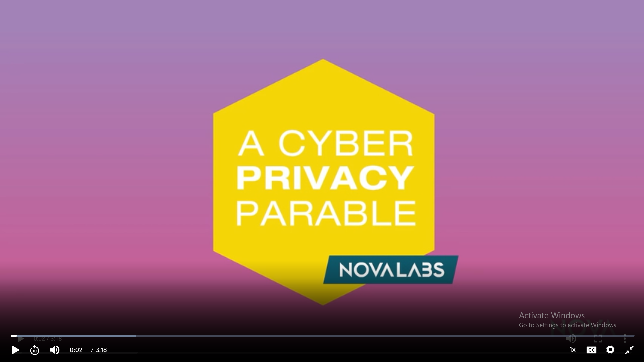
Level 2 | Digital Citizenship
What might happen when too much of our personal information is given out online
Notes:
https://www.pbslearningmedia.org/resource/nvcy-sci-parable/a-cyber-privacy-parable/

Slide 4

Identity theft
Had you ever heard of identity theft before?
Have you ever known or heard about someone who experienced identity theft?
Have you ever thought about the clues that a photo can give away? What about the photos that your friends or family post? Are they unknowingly giving out information?

Slide 5

Spot the Scam!
Match the type of fraud to the situation
Situation
Types of fraud
An email asking you to change your password for updating your account by clicking on a link
Greeting card scam
A text message on your phone informing you that you have won a big sum of money
Gaming scam
An email asking you to download a card from a secret admirer
Charity scam
A pop-up in your online game offering 100 free game coins if you follow the link and watch a 2-minute video
Email fraud
A message telling you that security has been breached on your messaging app and that you need to click on a link to reset your password
Lottery scam
A pop-up on your screen asking you to donate to those affected by recent floods
Messaging fraud

Slide 6
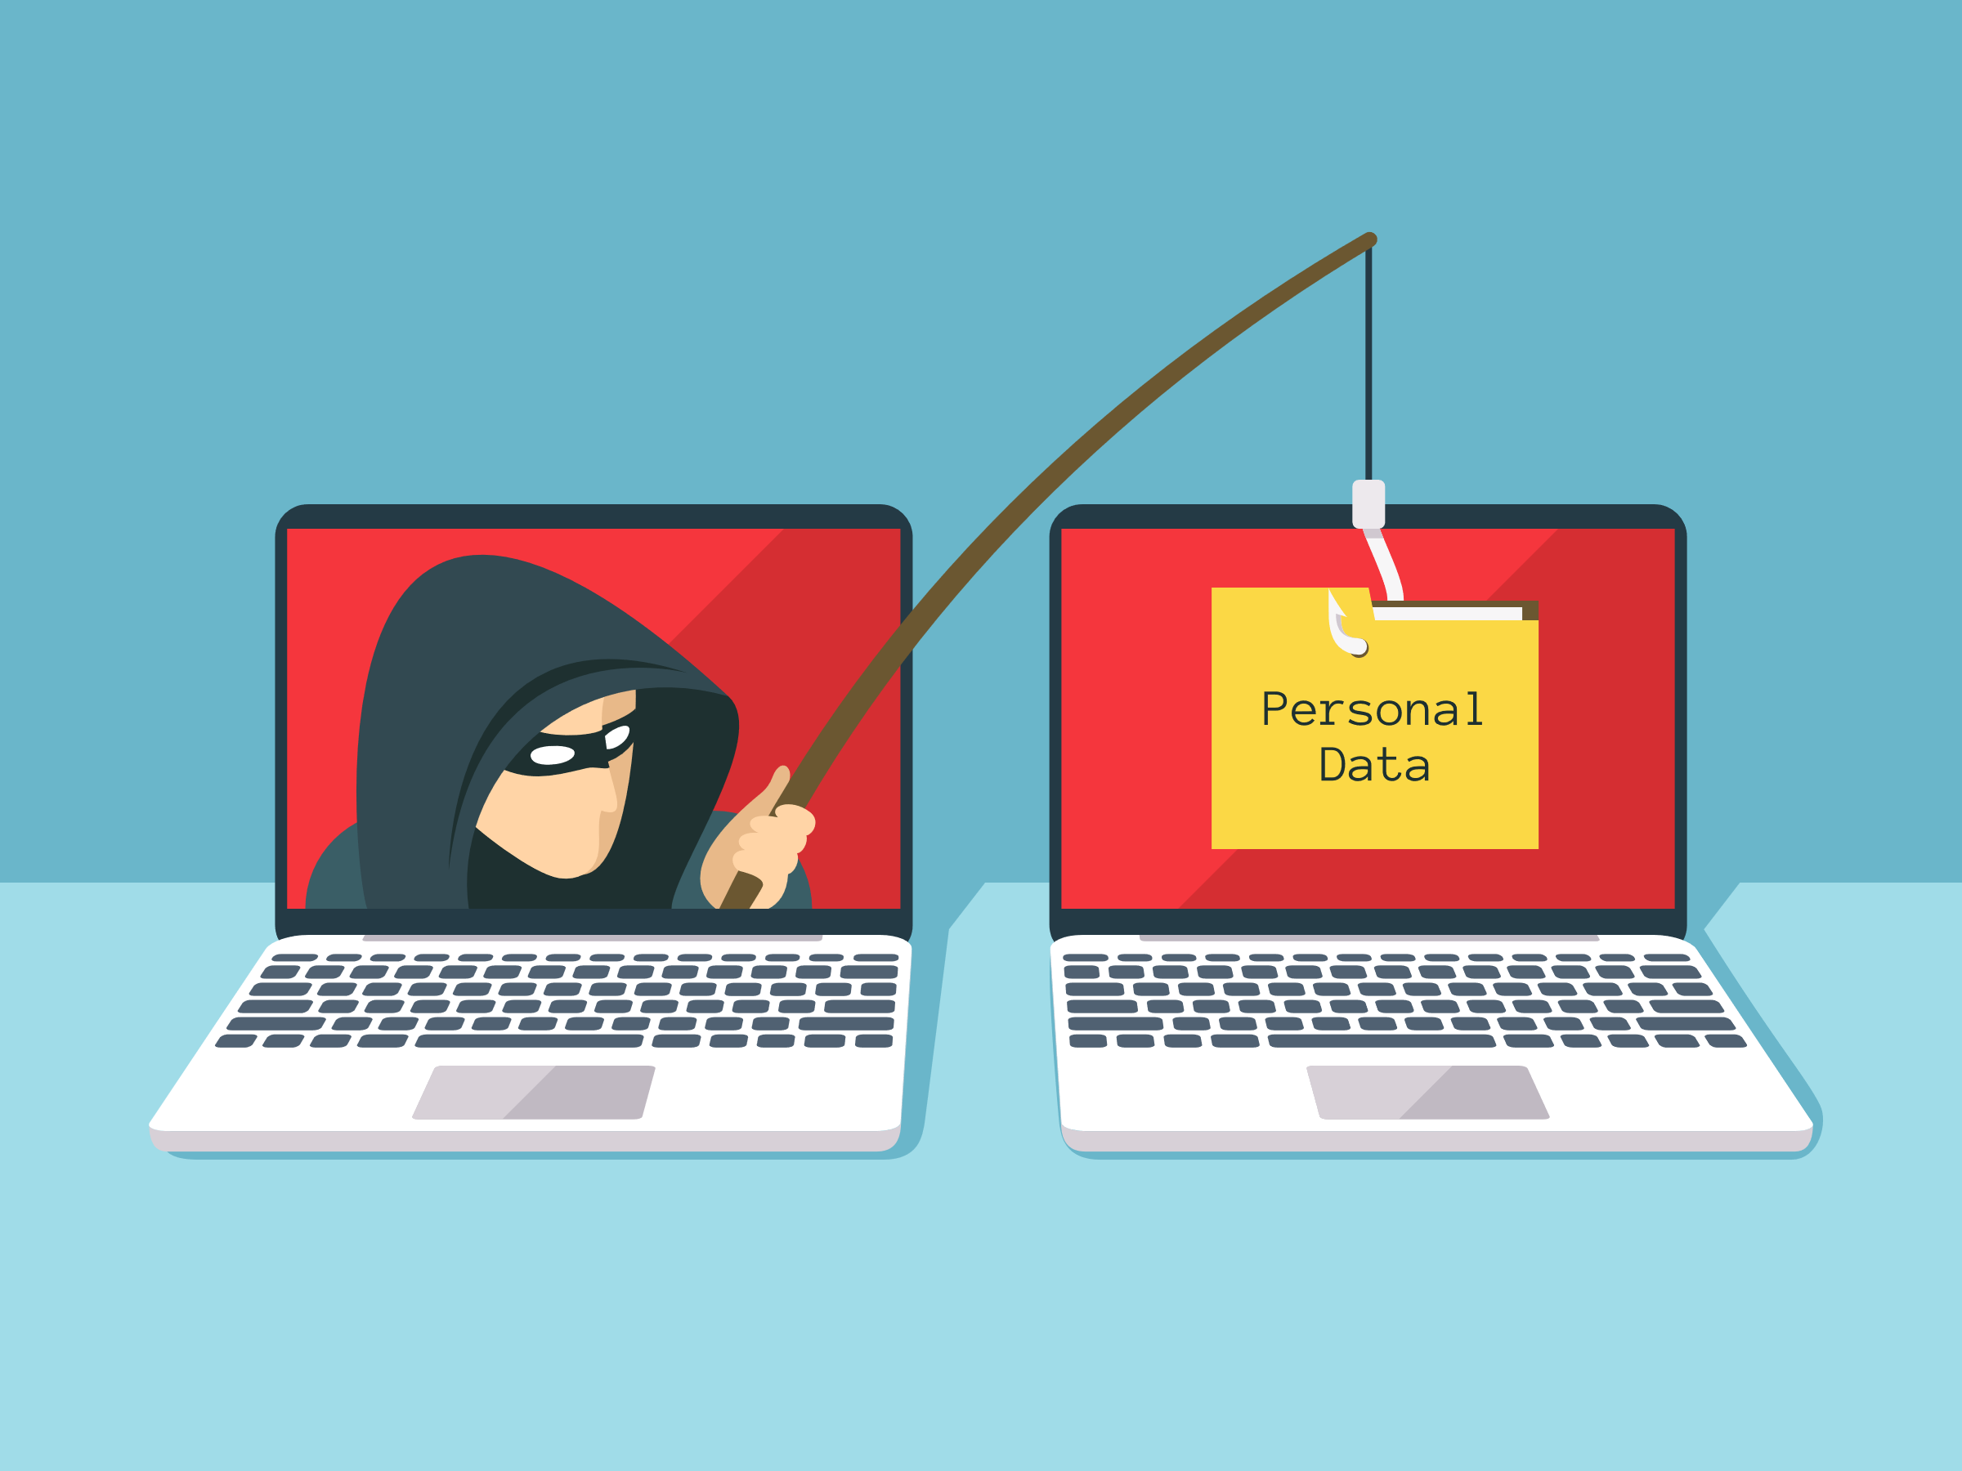
Phishing
What is phishing?
Phishing is a method of identity theft that relies on individuals unwittingly volunteering personal details or information that can be then be used for nefarious purposes. It is often carried out through the creation of a fraudulent website, email, or text appearing to represent a legitimate firm.
KEY TAKEAWAYS
Phishing is a type of data theft that involves people unknowingly volunteering their personal information to a bad actor.
A phishing attempt may utilize an official-looking website, email, or other forms of communication to trick users into handing over details like credit card numbers, social security numbers, or passwords.
Phishing websites can appear identical to official websites, prompting users to input their real credentials on the malicious website.
ccc

Slide 7

Level 2 | Digital Citizenship
How to catch a phish.
Click here
Notes:
https://docs.google.com/document/d/1yZlDV-IqykiQEr3K1Bmo5JjTHJ5UDwVfyxxSozWkXHY/edit

Slide 8

Strategies to avoid phishing
What are the key characteristics of these types of scams?
What could be some strategies to avoid phishing or other types of scams?
ccc

Slide 9

Take-home activity
Create a mind map covering the concepts of personal security and phishing attacks. Include what you have learned today.

Slide 10

Created by

