Slide 1

Digital Citizenship
Lesson 13
HOW TO IDENTIFY AND MITIGATE CYBER THREATS

Slide 2
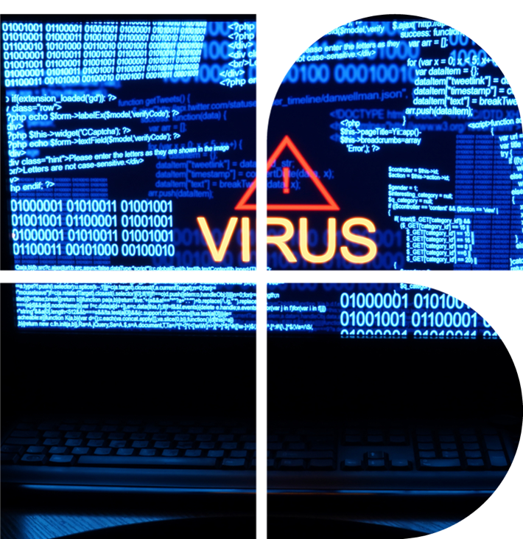
I have a virus!
Have you heard of the term ‘malware’ before? Do you know what it means?
Have you heard about computer viruses? What is your understanding of them?
How do you think that computer virus is similar or different to a physical virus which might make you fall ill?
Do you think it is possible to escape ever having a malware attack?

Slide 3


Definitions
Definitions You Should Know
Malware
Software that is specifically designed to disrupt, damage, or gain unauthorised access to a computer system. Malware is a catch-all term for any type of malicious software.
According to the UN, cybercrime (theft, embezzlement, data hacking, general destruction of sites and devices) has risen by 600% due to the COVID-19 pandemic.
Cybercrime will cost companies worldwide an estimated USD 10.5 Trillion annually by 2025 (up from USD 3 Trillion in 2015).
Computer Virus
A computer program that, when executed, can modify computer programs and insert different instructions which might be used to steal, modify or destroy data. A computer virus is a specific type of malware that self-replicates by inserting its code into other programs.

Slide 4


Level 2 | Digital Citizenship
Malware bug
Notes:
https://www.youtube.com/watch?v=V-WleeTocu4

Slide 5

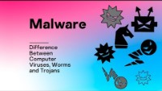
Level 2 | Digital Citizenship
Different types of malware
Notes:
https://www.youtube.com/watch?v=n8mbzU0X2nQ

Slide 6
Match the terms with the definitions
Worms
A bad code or program that attaches itself to a host to harm your device
Spyware
Software that copies itself to infect your device.
Ransomware
This program appears to be helpful, but once it’s downloaded it attacks your device.
Viruses
This software installs itself on your device and can steal your passwords, email addresses and personal information.
Trojan Horse
This software uses false advertisements online to infect your computer and steal your information
Adware
This software takes control of your computer and won’t release your data until money is paid to get it back.

Slide 7
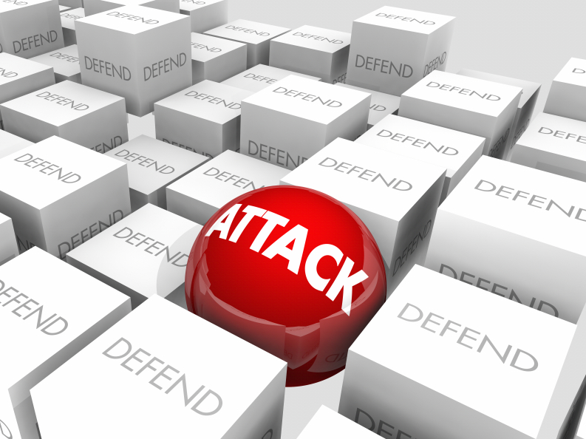
Defend and Attack!
In this activity, you will get a taste of how cybersecurity involves thinking about possible attacks.
There are two kinds of teams: Red Team and Blue Team
The Red Teams: you are trying to find out the secret information that the Blue Teams have
The Blue Teams: you will be in possession of some secret information which you must guard from the Red Teams

Slide 8
Defend and Attack!
Once your teams are established, you can meet for 3-5 minutes to discuss your strategies.
How will you obtain the secret information?
How will you defend your secret information?
You will be sharing your strategies with the class.
You can imagine that you can use any resources that would normally be available to you.

Slide 9

Attack
What are your strategies to obtain the secret information?
How did you choose the strategies that you thought would work the best?
Do you think you would be able to succeed?
Have you thought about what the blue team will do in response to defend themselves against your attack?
Red teams

Slide 10

Attack
What are your strategies to defend your information?
How did you choose the strategies that you thought would work the best?
Did you hear any attack strategies which you had not thought of?
What are your options to defend your data?
What can you do instead of sit and wait for an attack to come?
Blue teams

Slide 11
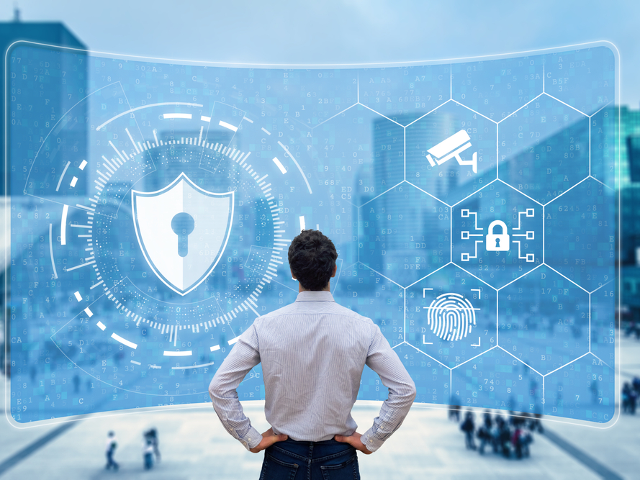
Strategies to avoid phishing
Imagine being a cybersecurity expert hired by a big company to prevent these kinds of data stealing attacks.
Which strategies from the Red Team/Blue Team exercise do you think would work?
Now that you have had time to think about it, are there any other ideas on how to protect your data?
ccc

Slide 12

Level 2 | Digital Citizenship
Take-home activity
How do you think that Cybersecurity attacks impact us as individuals and as a society?
Think through all the various impacts
Document the impacts
Does this make you feel more concerned to ensure that your data is protected?

Slide 13

Created by

