Slide 1
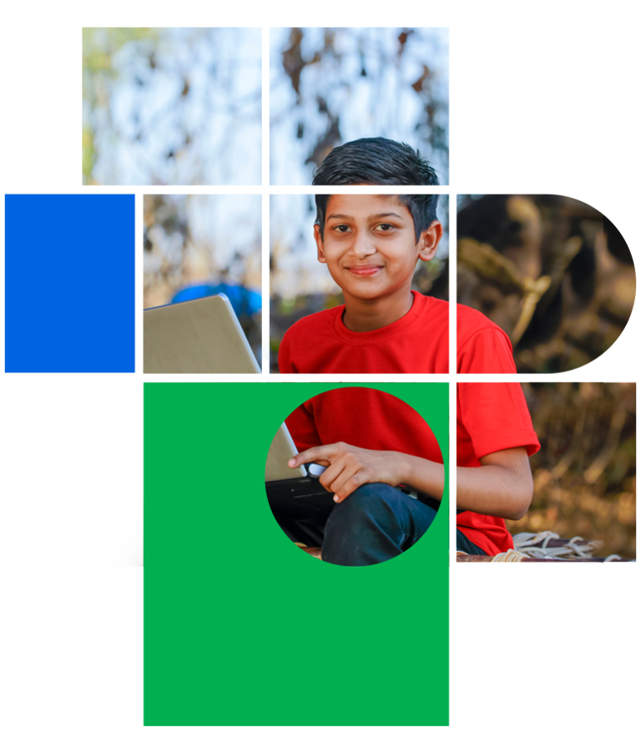
Digital Citizenship
Lesson 4
WHAT IS YOUR ONLINE PERSONA?

Slide 2
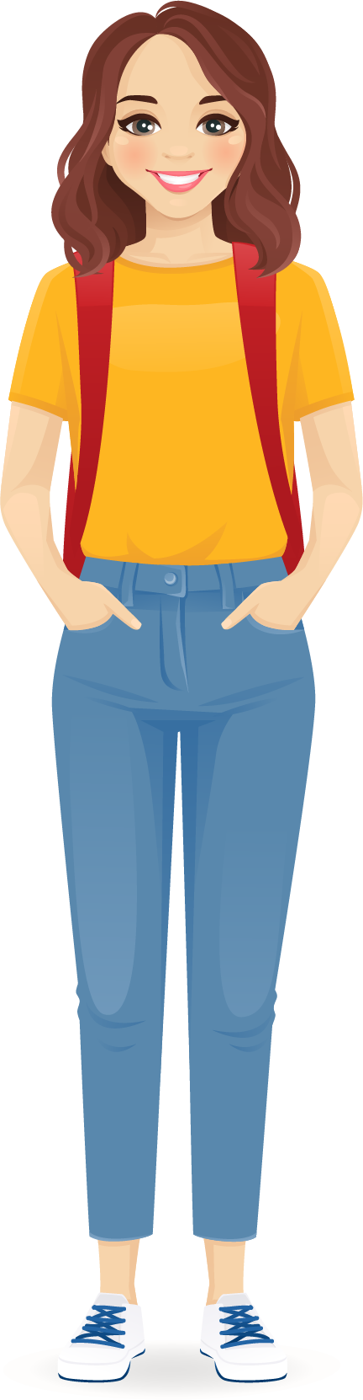
Rhea’s story
Let’s meet Rhea
Rhea is a quiet and shy teenager who isn’t old enough to have a public profile on social media sites. Her parents too are not comfortable with the idea of her being active on this site that’s extremely popular with teenagers. But most of her friends are there and Rhea doesn’t want to miss out on the online interaction and fun.
She creates a profile and goes by the name of Rheanna and shares all kinds of information about herself there, including photos, videos. She feels confident and is much more outgoing than she would be in real life. She tells her friends about her fake profile so they can become her friends online. She shares a lot of personal information and posts pictures frequently. She tries to choose pictures that make her look older and more grown up. She keeps it a secret from her family.
On one occasion, Rhea participates in making fun of a new student as all her friends are doing it. They post disrespectful comments on the student’s social media; the matter escalates as the student complains to the school authorities about online bullying.

Slide 3

Discussion
What could Rhea have done differently?
How do you think Rhea’s parents will react when they find out?
If you had to create a social media profile, what two things would you do to keep it real and authentic?
What would be one thing that you would avoid or not do?

Slide 4
Tips
Remember to THINK!
What’s not OK :
Sharing or uploading inappropriate messages, images, and videos
Saying or doing something online that you would not say or do face-to-face
Posting images of others without their consent
Is what you are about to post:
True?
Helpful?
Inspiring?
Necessary?
Kind?

Slide 5

Persona & Reputation
Persona
The aspect of someone’s character that is presented to or perceived by others.
Reputation
Beliefs or opinions that are generally held about someone or something.

Slide 6
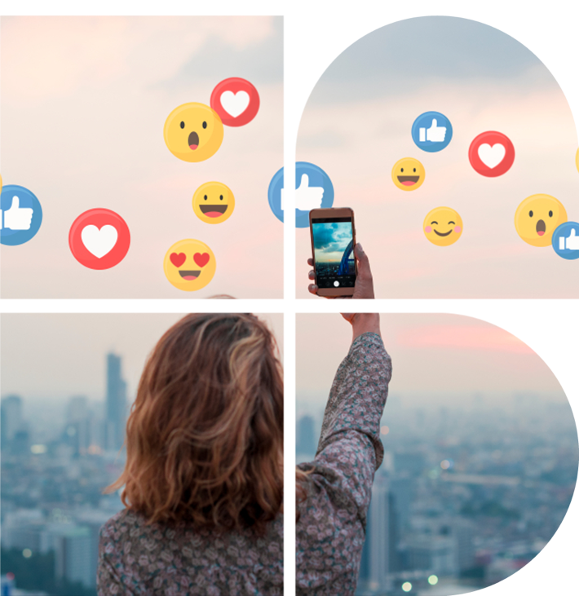
How do others act online?
Name two celebrities or influencers that you follow in the news or online. What qualities do you admire about them?
How do they conduct themselves online?
Has there ever been any controversies for something that they posted?
How about others?

Slide 7
Activity: Positive and Negative Footprints
Positive Footprint
Negative Footprint
Posting pictures of my artwork or photos of wildflowers
Posting mean comments about my teacher who gave me low marks

Slide 8

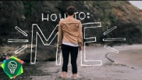
Level 2 | Digital Citizenship
Who is the real you?
Distinguishing between the online and offline self.

Slide 9



Level 2 | Digital Citizenship
Take-Home Activity
Write a blog post on one of the following:
Use of filters and photo manipulation on social media platforms
The “real me” vs the “social media me”

Slide 10

Created by

