Slide 1

Digital Citizenship
Lesson 7
HOW TO BE AN ALLY TO A CYBERBULLYING VICTIM

Slide 2


Bystanders and Upstanders
Level 2 | Digital Citizenship
When you see a case of cyberbullying, what can you do about it?
Video:
Who is a bystander and who is an upstander.
Notes:
https://www.youtube.com/watch?v=eeqQCyQOCPg

Slide 3
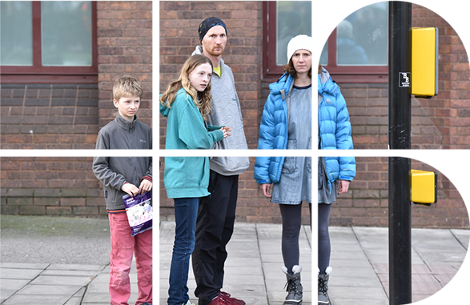
Upstanders and Bystanders
What is a bystander?
What might cause someone to be a bystander in a bullying situation? Have you ever witnessed a bullying situation before?
Who is an upstander?
What are the four ways to be an upstander?

Slide 4

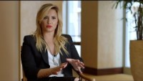
Level 2 | Digital Citizenship
Cyberbullying can happen to anyone!
Demi Lovato's experiences with cyberbullying.
Notes:
https://www.youtube.com/watch?v=KNwM9tgvuiY

Slide 5
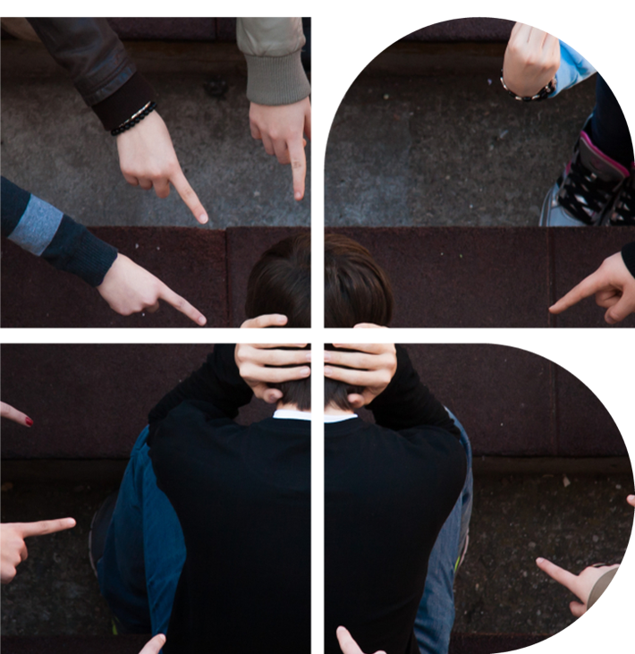
What are the different roles in a bullying situation?
Can you explain in your own words what each of these roles is?
The bully
The victim
The bystanders
The upstanders

Slide 6
Scenarios: Evaluate the Reactions
Place a tick mark under Upstander or Bystander for each reaction given
Scenario 1:
Reaction | Upstander | Bystander
Call Samir and tell him you don’t like this any more than he does and ask him what he thinks you two should do.
With Samir’s agreement, call all the other players and get everyone’s agreement that it’s time to call out the nastiness.
Decide to wait and see if the bully stops, then maybe do something.
Walk away from the game for a while.
Look up the game’s community rules and if bullying isn’t allowed, report the nasty behaviour using the game’s reporting system.
There’s an online game that you and your friends play regularly. Usually, there is a lot of game chat amongst the players, mostly talking about the game. There is occasionally some friendly rivalry and teasing about who is playing well and who is making mistakes. One day, one of the players starts being nasty to your friend Samir, and they just won’t stop. It’s beyond teasing. The next day, the same thing happens. You …

Slide 7
Scenarios: Evaluate the Reactions
Place a tick mark under Upstander or Bystander for each reaction given
Scenario 2:
Reaction | Upstander | Bystander
Feel sad for Ria but do nothing because no one knows who sent the mean messages.
Go find Anushka and ask her how she feels and whether you can help.
Spread the drama by sharing the mean message with other friends.
Help Ria to get everybody on the football team to post compliments about Anushka.
Report the incident to your principal, inquire if she can help and ask her to ensure that all students learn about good phone security and locking their phones.
Ria, a friend of yours, dropped her phone by the drinking fountain near the school football field. Someone found it and, using Ria’s phone, sent mean messages about Anushka to the other members of the football team. After doing this, they put the phone back near the drinking fountain. Anushka confronted Ria and told her that she was a terrible person for sending such mean messages. Ria tried to tell Anushka that she was not the one who sent the messages but Anushka didn’t believe her. No one knows who really sent the mean messages. You …

Slide 8

Rules:
You need a minimum of two players.
Use a coin or other marker for gameplay.
Using one dice, each player rolls to see who begins the game.
The person with the highest roll starts the game, play will move to that person’s left.
Each player rolls one dice and moves ahead the number of squares shown on the dice.
The player will read out loud the message on the square and take the action indicated.
If a player lands on a square with no message, their turn ends and the next player takes their turn.
Play proceeds until a player reaches the WINNER square (you do not need to reach by exact count).

Slide 9
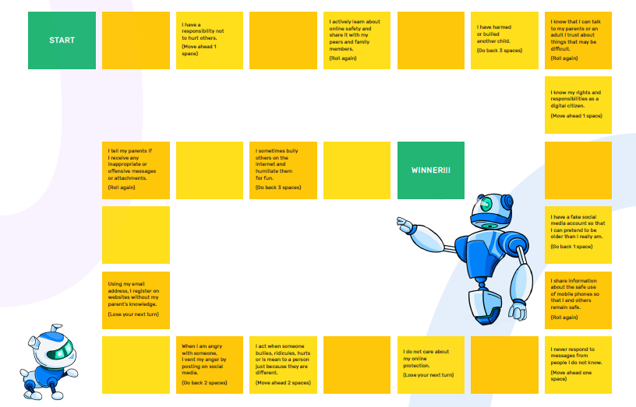
Watch out!

Slide 10
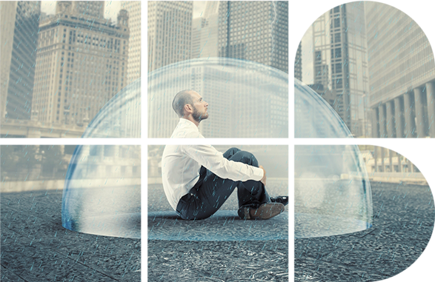
My Protection Poster
You should always have an idea of who you would call in an emergency and how to reach them.
Your protection poster will be this list of people who can help and their phone numbers
Keep it current by updating it from time to time
Once you have completed your poster, you can keep a copy with you in your school bag or other safe location

Slide 11

Created by

