Slide 1

Digital Citizenship
Lesson 9
LET’S SCRUTINISE YOUR SCREEN TIME

Slide 2


Level 2 | Digital Citizenship
What is your screen time?
Digital media tries to hook you, and what can you do about it?
Notes:
https://www.commonsense.org/education/digital-citizenship/lesson/digital-media-and-your-brain

Slide 3
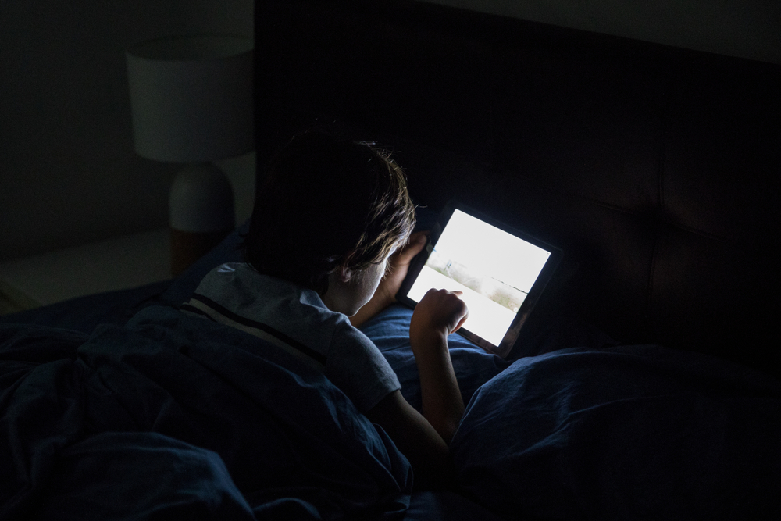
Level 2 | Digital Citizenship
What is your screen time?
What do you estimate your average screen time is?
How about for your friends?
What are you doing during most of this time? Do you know?
Let’s try to estimate how you are spending your screen time.

Slide 4
What is your screen time?
Estimate how much time you spend on screens over the course of a typical Friday and Saturday
Friday
Count | Activity | Device | Number of Hours | Active or Passive
1 | Online Class | laptop | 4 | Active
2 | Watching a movie | TV | 2.5 | Passive
3
4
5
6
7
Saturday
Count | Activity | Device | Number of Hours | Active or Passive
1
2
3
4
5
6
7

Slide 5


Level 2 | Digital Citizenship
How much is too much?
Five ways to improve our digital well-being.
Notes:
https://www.commonsense.org/education/videos/screen-time-how-much-is-too-much

Slide 6

Analyzing your screen time
How much time do you estimate you are spending on screens on the weekend?
ccc
Was this as expected? More than? Less than?
Which devices are you using the most?
Are any of your screen time activities group activities or are you using your screen by yourself?

Slide 7
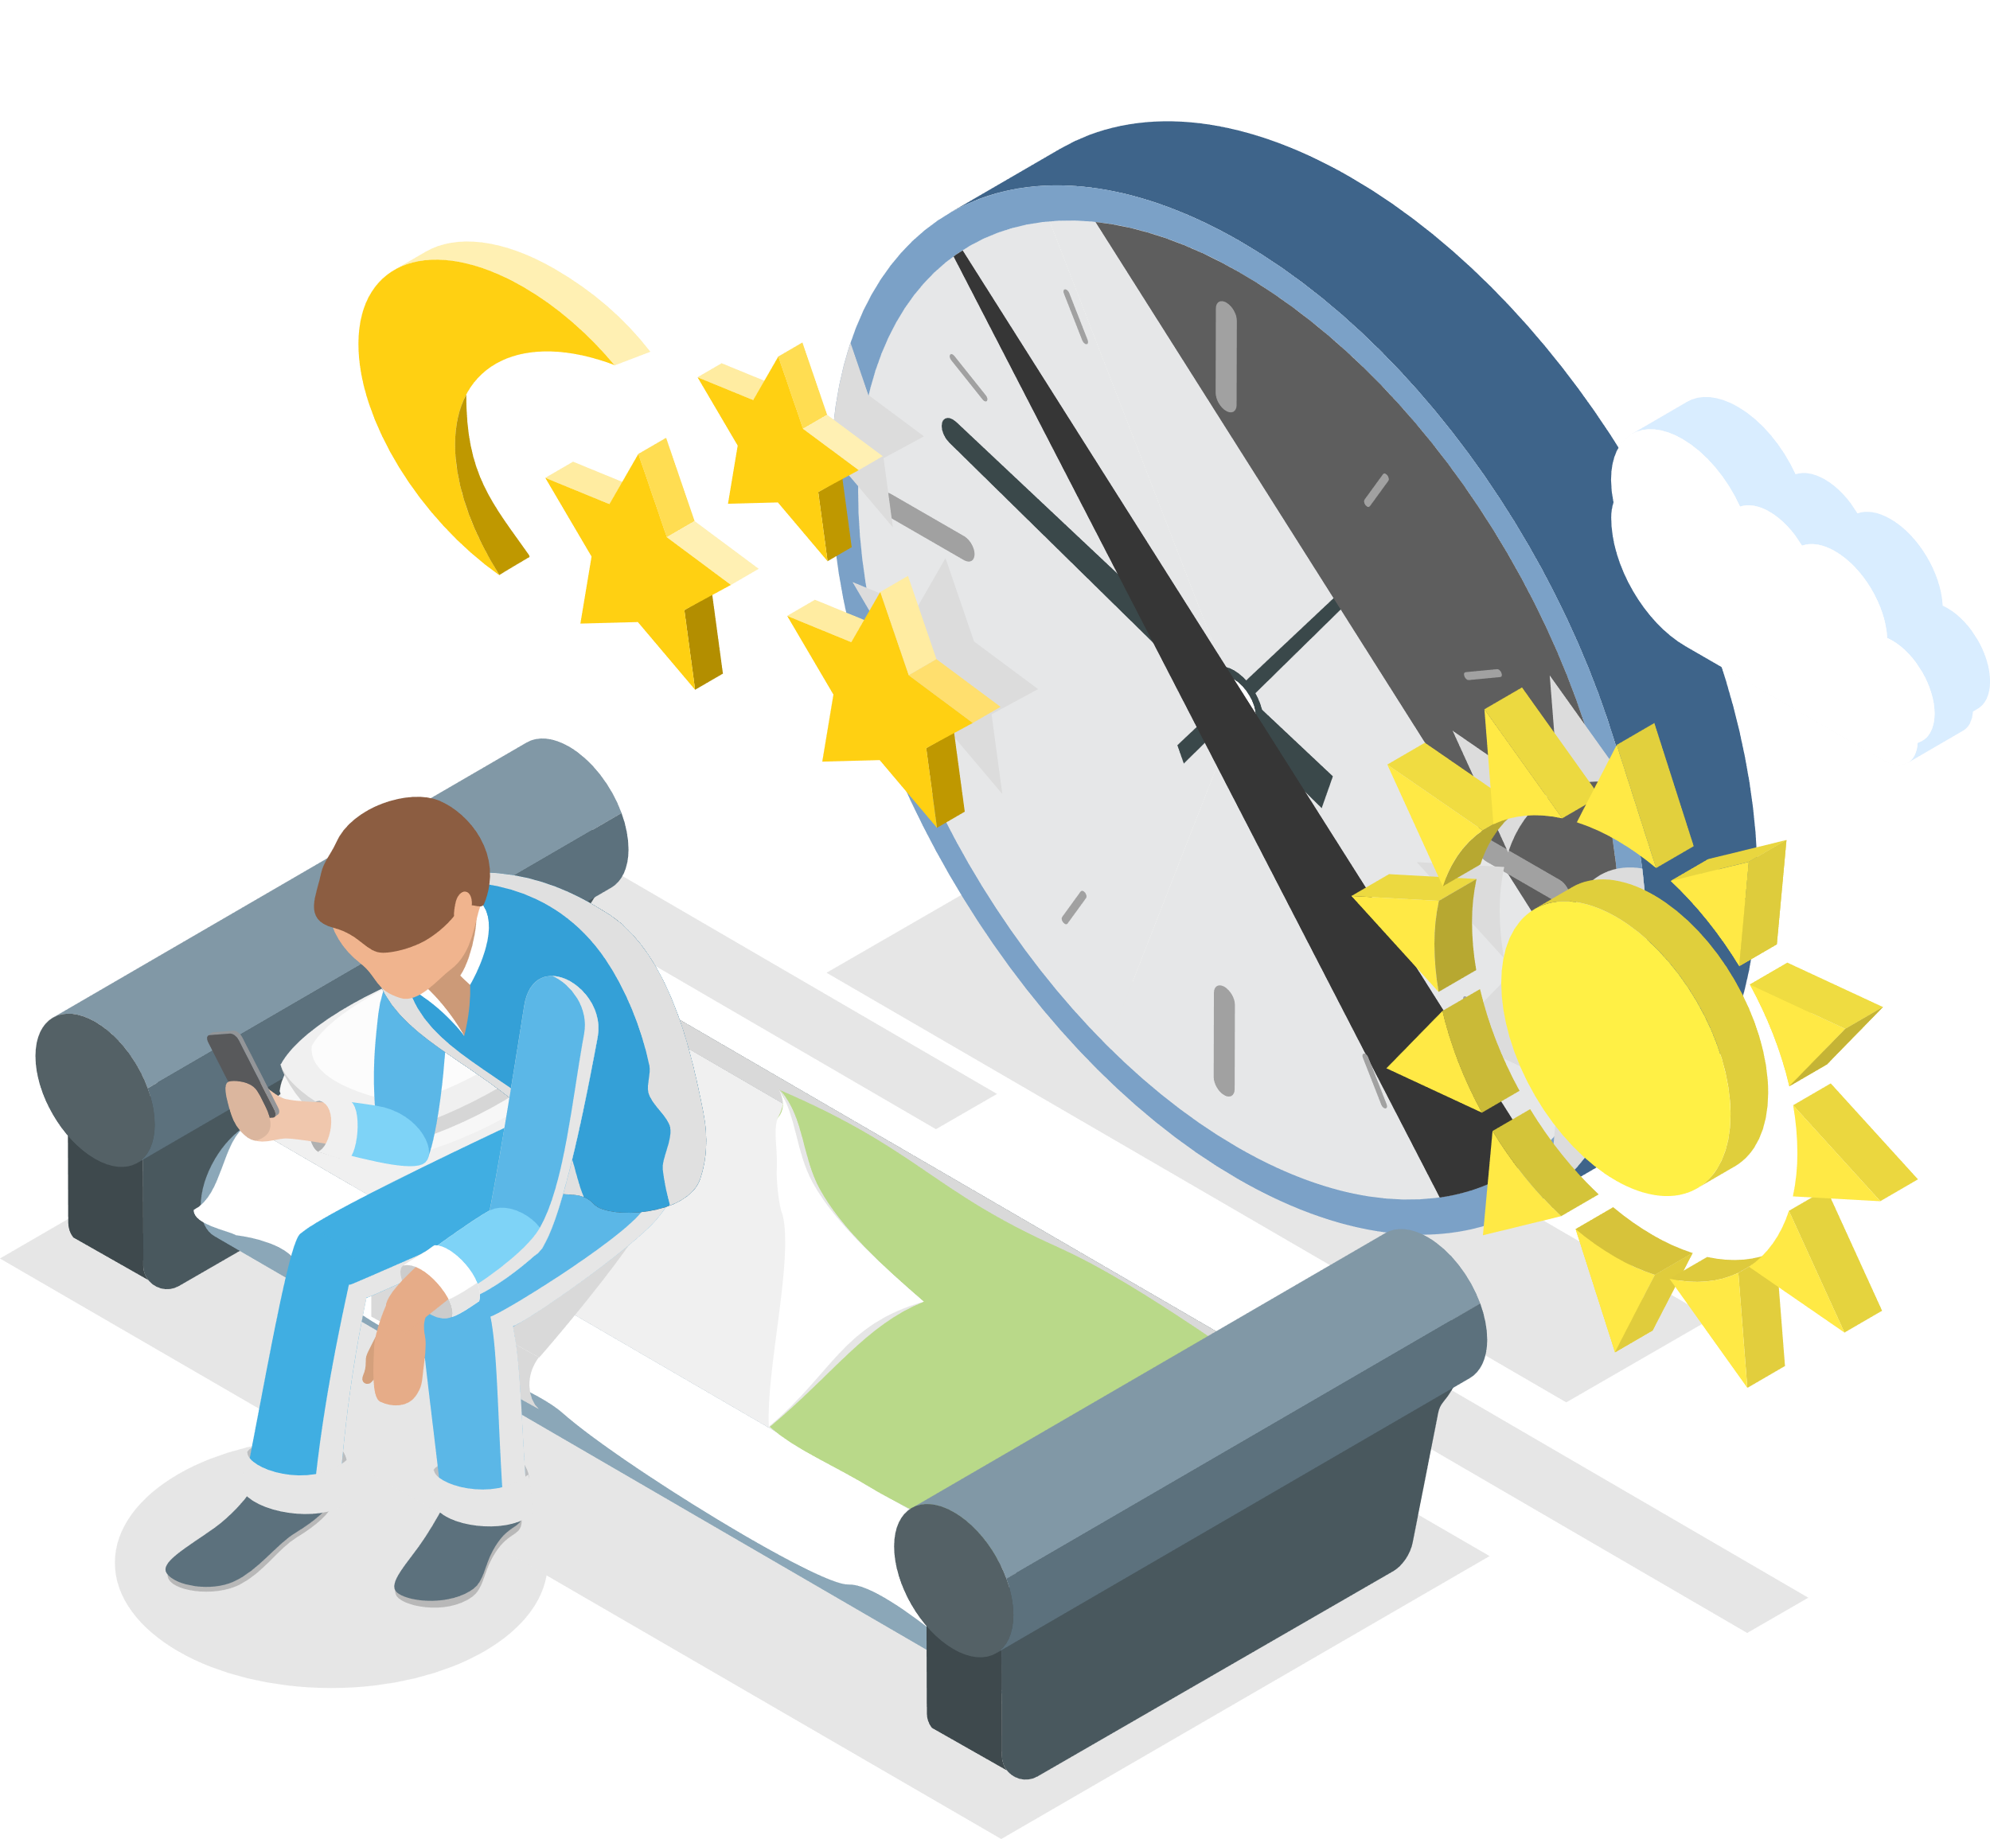
Let’s understand active and passive screen time
Active Screen Time
Passive Screen Time
Active screen time refers to active or mentally or physically engaging screen time.
Passive screen time refers to the passive or non-interactive consumption of digital content.
This means that we are engaging actively, possibly learning, thinking, or interacting with someone through an activity.
This is usually done with minimal thought, creativity or interaction.
Examples may include video games like Nintendo or Xbox, video chatting, creative activities such as coding, drawing, making music or a video, taking and editing pictures.
Examples may include scrolling through a social media site, watching a film on TV, watching videos on YouTube or playing a game that doesn’t involve much thinking or physical activity.

Slide 8
Identifying active and passive screen time
Activities
Active
Passive
Watching my favourite artiste’s video on YouTube
Scrolling my Instagram feed
Playing tennis on my Xbox
Watching cat videos on social media
Making a video to upload on Snapchat
Taking a Chemistry lesson online
Watching a movie on TV
Reading an article on my favourite football team’s chances in an upcoming game
Playing Fortnite with friends
Binge-watching my favourite show on Netflix

Slide 9
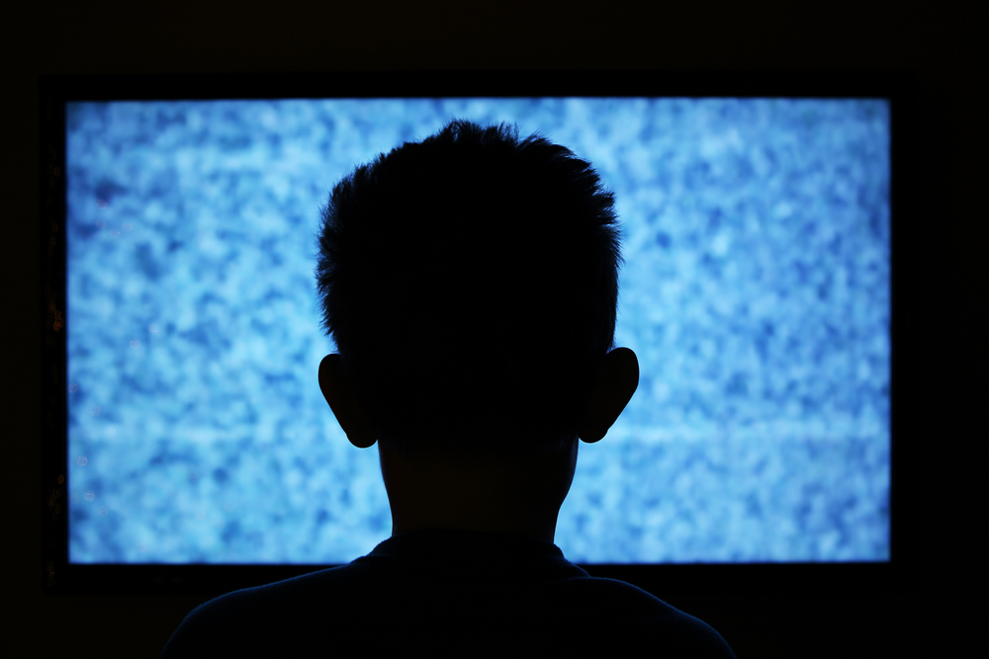
Getting rid of passive screen time
Based on your own estimates, what is the biggest contributor to your passive screen time?
What are your ideas on how to change this?
Have you ever experienced any negative physical effects due to excessive screen time? How did you feel?
What would you like to do differently?
cc
cc

Slide 10
True or False?
Next to each of the following statements, indicate whether you think it is true or false.
Since passive screen time takes less energy, I should do it for longer.
More research is needed to fully understand the impact of excess screen time.
Scrolling on social media is a good example of active screen time.
People tend to underestimate how much time they spend online.
Eye strain or a sore neck could be symptoms of excess screen time.
Watching YouTube in bed right before sleeping is a great way to get a good night’s sleep.

Slide 11

Created by

